Slide 1
Box Office Gross Prediction
Hernan Trujillo
Metis 07.09.2021

Slide 2
AGENDA
INTRO
APPROACH
RESULTS
FUTURE WORK
APPENDIX

Slide 3
INTRO

Slide 4
Data Source: Box Office Mojo
Web Scraping
Modeling
Beautiful Soup
+1.,000 movies
10 Features
2015-2019
Regression
LASSO
RIDGE
FE

Slide 5
2. APPROACH

Slide 6
#1
#2
#3
$ 1,873,324,450
$ 1,240,362,764
$ 1,064,354,648
Top Movies
Star Wars: Episode VII - The Force Awakens
Star Wars: Episode VIII - The Last Jedi
Rogue One: A Star Wars Story

Slide 7
Features
Title
Distributor
Domestic Gross
Budget
Release Season
Rating
Genres
Running Time

Slide 8
3. RESULTS

Slide 9

Outcome: Predict total domestic gross

Slide 10
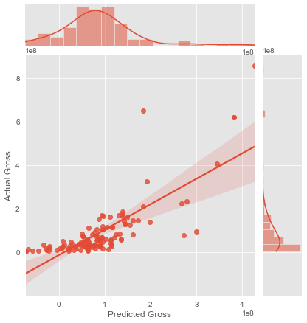
LASSO CV
0.579
R^2

Slide 11
4. FUTURE WORK

Slide 12
FUTURE WORK
3
1
2
Additional Scrapping
Cast and Crew Analysis
Time Series

Slide 13
5. APPENDIX

Slide 14
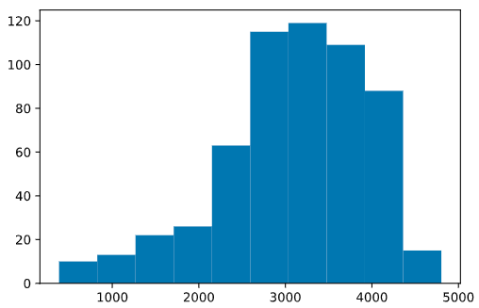
WIDEST RELEASE
Number of movie theaters where the movie was released

Slide 15

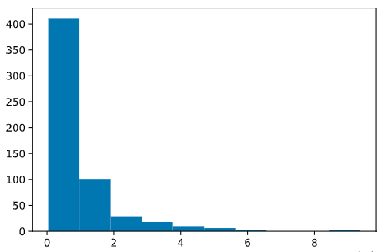
DOMESTIC GROSS
Target

Slide 16
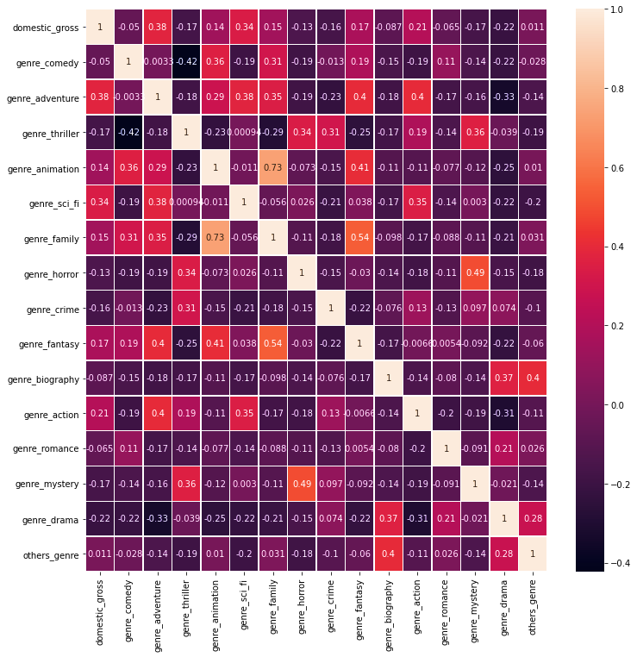
Genres
Correlation among genres and the target

Slide 17
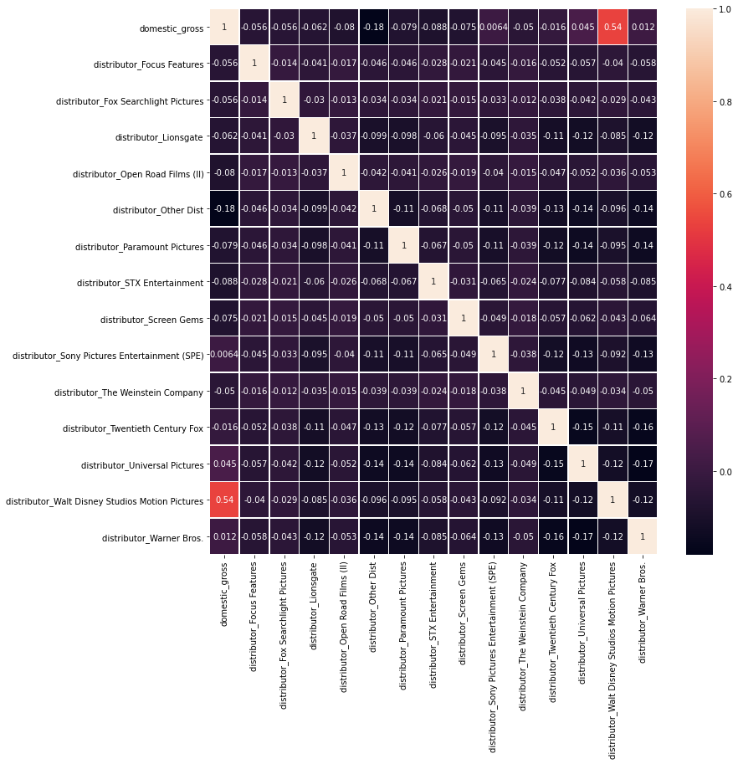
Distributors
Correlation among Distributors and the target

Slide 18
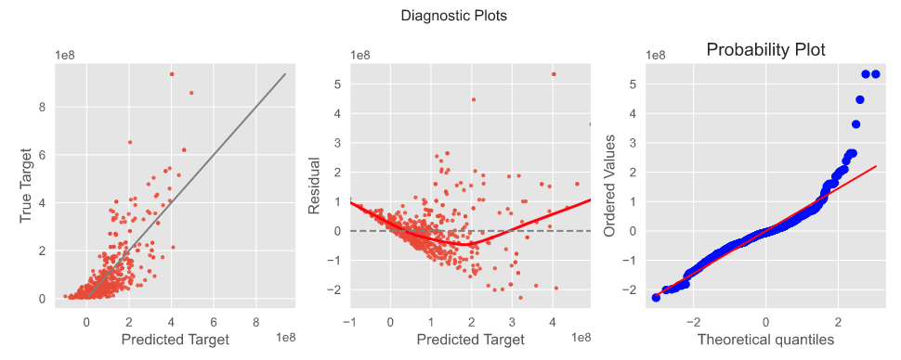
DIAGNOSTIC PLOTS

Slide 19
THANKS!
hernantru943@gmail.com.com

